Slide 1
Lecture 7.4 Decision rights

Slide 2
Decision Rights
Decision right: the right to decide on and take an action.
Decision rights are alienable:
Decision rights can be sold and the proceeds of sale captured by the owner. i.e. decision rights are property rights
Alienability is the means by which knowledge and decision rights are collocated.
In a capitalist economy (markets) the problem posed by knowledge is solved via alienability. Alienability is the foundation of markets.

Slide 3
Decision Rights
Alienability solves the rights assignment problem and the control problem. Alienability ensures that markets result in:
Knowledge co-located with decision rights
Effectively controls decision makers by determining what they can and cannot do
Alienability and the process of voluntary exchange ensures that knowledge and decision rights are allocated in an optimal way.
Market prices reflect the capital value of those rights and ensure they are allocated efficiently because they:
Measure performance of those who have the decision rights to how assets are used.
Effectively reward or punish holders of the decision rights

Slide 4
Decision Rights
This is not what happens in organisations where decision rights and their alienability are generally not delegated. The market mechanism is suspended.
So how do organisations solve the rights assignment and control problem?
Ultimately, distribution of knowledge and decision rights is central to understanding organisations and organisational structure

Slide 5
Decision Rights
What are the benefits of suspending alienability of decision rights?
Perhaps there are benefits from economies of scale or scope, or the reduction in transaction costs. That is, firms must gain a net benefit from the suppression of the alienability of decision rights.
Perhaps more importantly, the organisation or firm allows the knowledge to be collated under one ‘hat’.
Nonetheless the problem remains: how to ensure that the benefits associated with alienability are not lost in the firm. That is, the incentives to make good decisions by virtue of the capitalised value of the decision right being incurred by the holder of the decision right.

Slide 6
Decision Rights
What must firms do?
They must tradeoff or balance:
Information Costs: centralisation of decision making requires costly information transmission to central decision makers. Information costs will fall as decision rights are assigned to those who have the specific knowledge required to support good decisions.
Agency costs: the sum of the costs of designing, implementing and maintaining an appropriate incentive control system, plus any residual loss from factors such as inconsistent decisions.

Slide 7
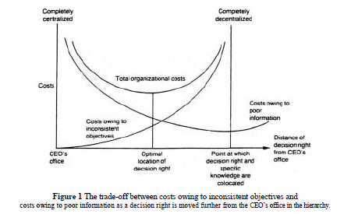
Decision Rights
The firm will want to minimise total organisational costs – those associated with information and agency costs. This is demonstrated in figure 1 in Jensen & Meckling.

Slide 8
Decision Rights
How?
A hierarchy: The allocation of decision rights.
A set of rules: an appropriate incentive and control system.
An incentive and control system
Partition decision rights: through job descriptions, budgeting, rules and regulations within the firm
Create a control system with incentives: specify performance measurement and rewards/punishment

Slide 9
Decision Rights
Decisions can be characterised in four stages:
Initiatives: identify options (e.g. cut staff, renegotiate supplier contracts).
Ratification: choose among different options.
Implementation: ask what tactics to use, i.e. how to achieve desired outcome.
Monitoring
Suppose a plant manager is told to cut costs by 10 percent. You may wish to:
Decentralise option identification and implementation – sometimes referred to as decision management.
Centralise ratification and monitoring.
This balances use of specific and general knowledge and recognises incentives.

Slide 10
Decision Rights
Consider the a board of directors in some organisations.
While the CEO has responsibility for decision management (the initiation and implementation of major projects for example), the board exercises decision control by ratifying and monitoring decisions.
Such an arrangement has the potential to mitigate potential incentive problems.
Of course, this may not be an option in smaller organisations, but in those cases, the incentive problem is often muted.

